Slide 1
What’s Cookin’
Good Lookin’ ?
Studio Theme: Engagement in Digital and Physical Space
Team 3: Julia Rose Chin, Britney Ky, Dylan Ly, Ji Hong Ni
Notes:
○ List and introduce your team members (also verbally introduce everyone)
○ Our problem domain is the cooking and we will be engaging with the digital and physical space

Slide 2
1. Needfinding Methodology
Who? Why? How?
Notes:
Needfinding Methodology (3-4 slides, include images)
○ Make sure you say who your participants were, why chosen, how they were recruited/compensated, and where they were interviewed (include images)
○ What did you ask?

Slide 3
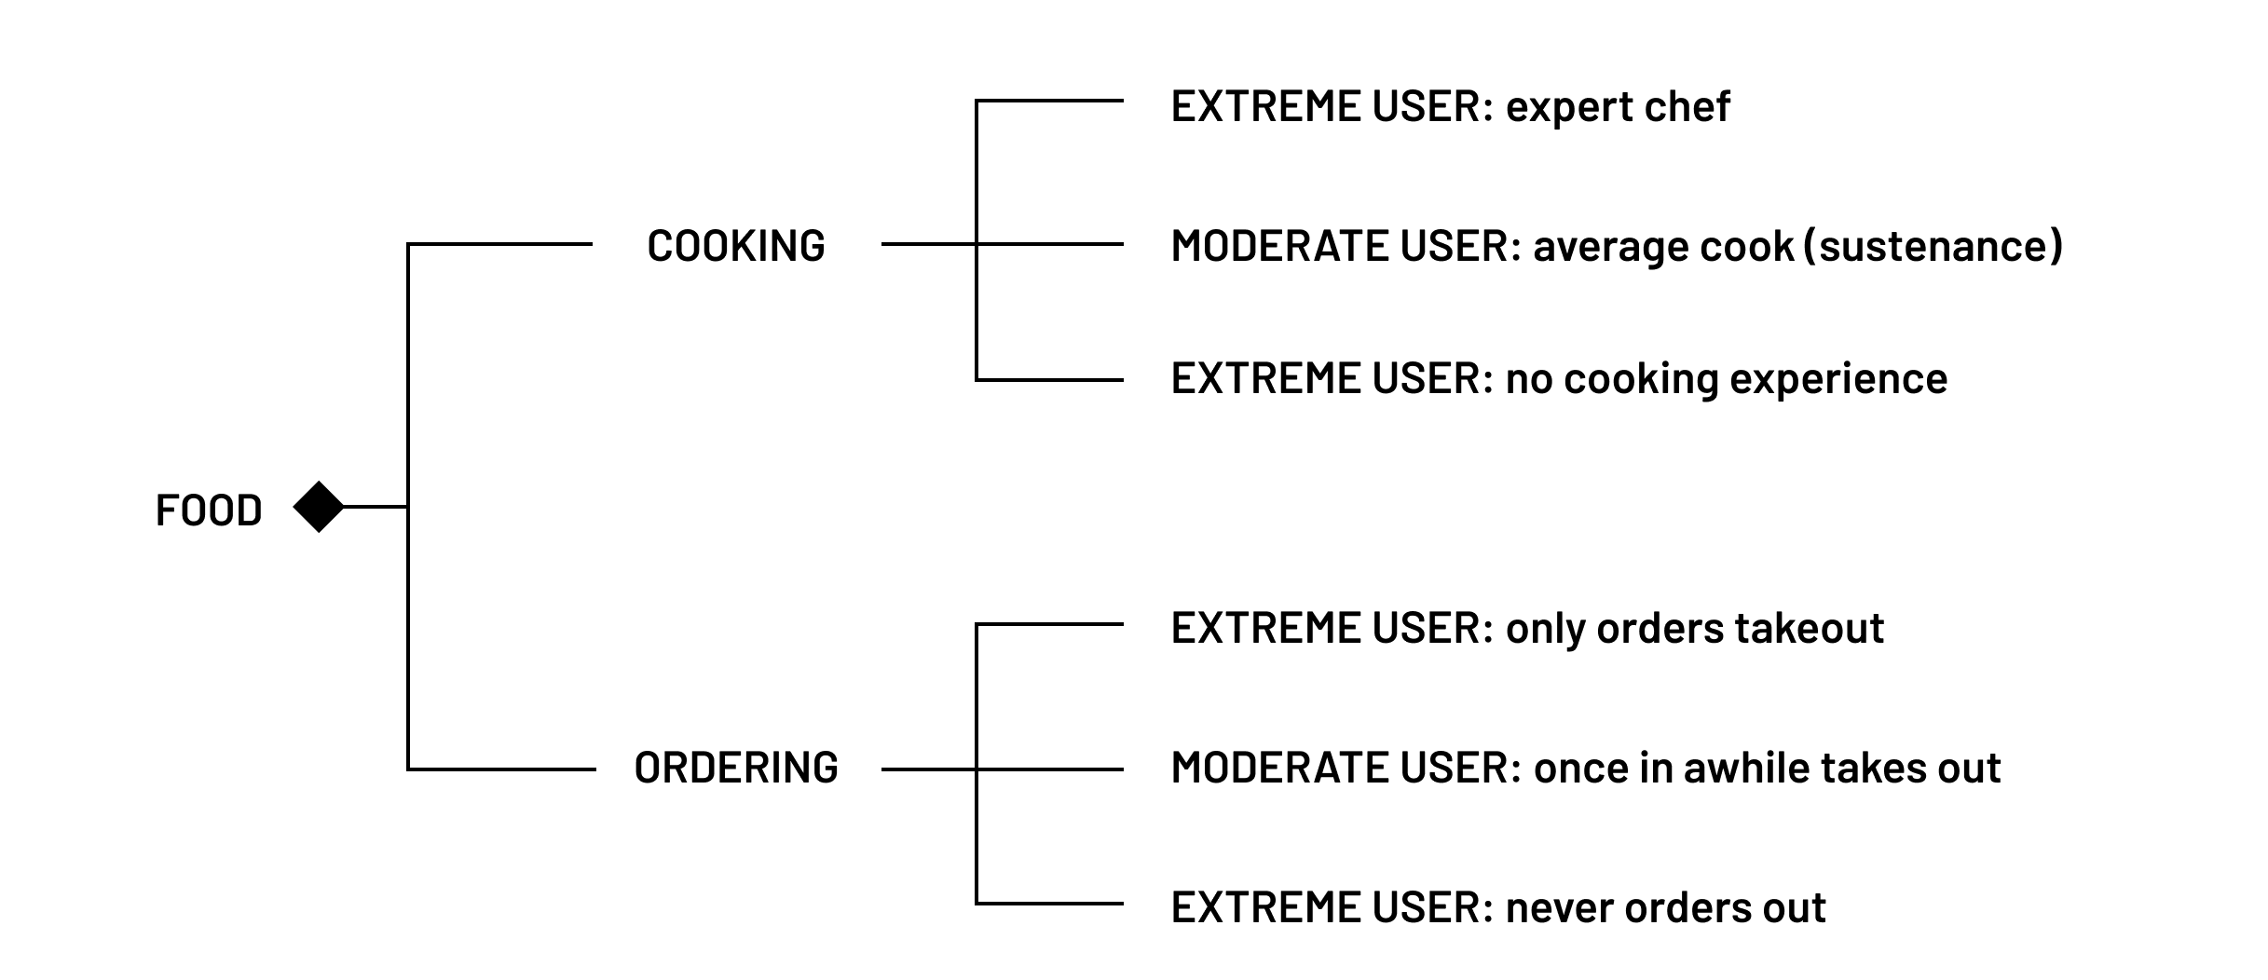
Target Audience
Notes:
We decided on the food space and upon discussion, found 2 paths of different users
Separate into cooking and ordering
Each of these has their spectrum of different users

Slide 4
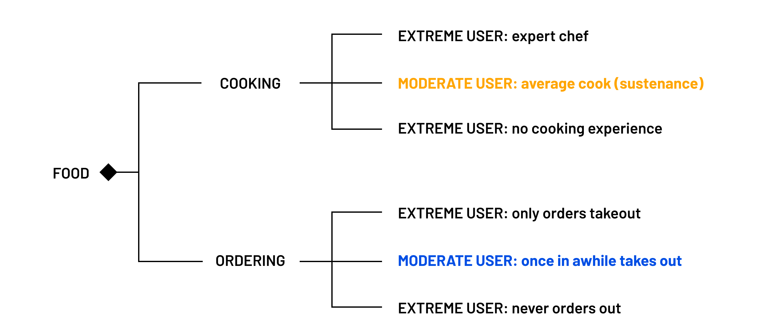
Target Audience
Notes:
Planned to focus on the moderate users that we labeled as the “average cook”
Someone we imagined cooked for sustenance, so mainly out of necessity
We plan on interviewing still, extreme users and also moderate users from the other branch to see if there is any insight the two can provide
Some extreme users we plan on interviewing is someone who doesn’t know how to cook (even toast), a mother who cooks more often than needed,
Why these users?: seemed to be the largest target group, encompassing a large amount of users

Slide 5
Questions
How do you get your meals every day?
How often do you cook?
How do you feel about cooking?
How experienced of a cook do you consider yourself?
How do you decide what to make?
Can you describe your process of cooking after you decide?
Could you tell us about a time you felt positive/negative while cooking?
How do you feel about ordering out?
Notes:
Tried keeping them open ended and in each of our interviews, these acted as a guide
The conversations continued naturally
We focused on eliciting emotion and storytelling while talking about the space
We have more older interviewee’s lined up too to see how the generational gap can impact these answers

Slide 6
Interviews
Notes:
Analysis (3-4 slides)
○ Empathy Map with highlighted components of what you found important/interesting
○ Discuss tensions, contradictions, surprises in the interview
○ Inferences, conclusions, or questions you might have about your results
○ Initial assessment of “needs” and “insights”

Slide 7
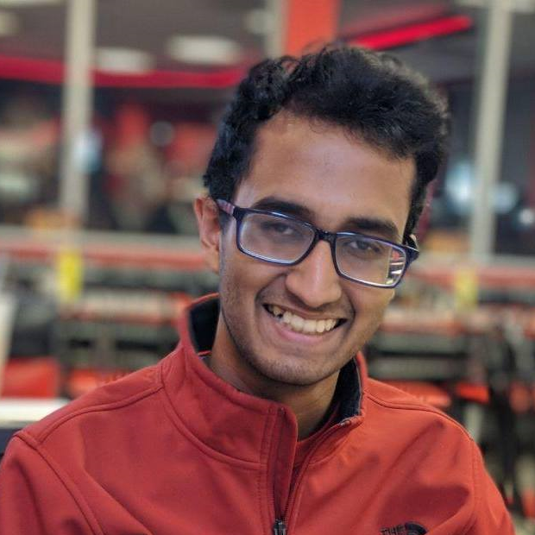
Interview 1
“I guess it's kind of more rewarding actually because like [the food] feels like more like your own work. It's like, yeah, I made this… [it’s] my child, you know.”
Abhinav
A Microsoft employee who works alone and cooks with others
Notes:
● Interview Results (3-4 slides)
○ Discussion of results, pictures, quotes, and surprises you gleaned from your interviews
Software engineer who lives/ cooks with family
Cooks about half of the time of the week
Ambivalent toward cooking
Prefers takeout, understanding that it is faster but has pitfalls arguably worse than cooking (cost)
Generic google searches
SURPRISING: ambivalent toward cooking and only signifigant memory he had was making 4 pizzas for thanksgiving, noted this as a large, challenging task

Slide 8
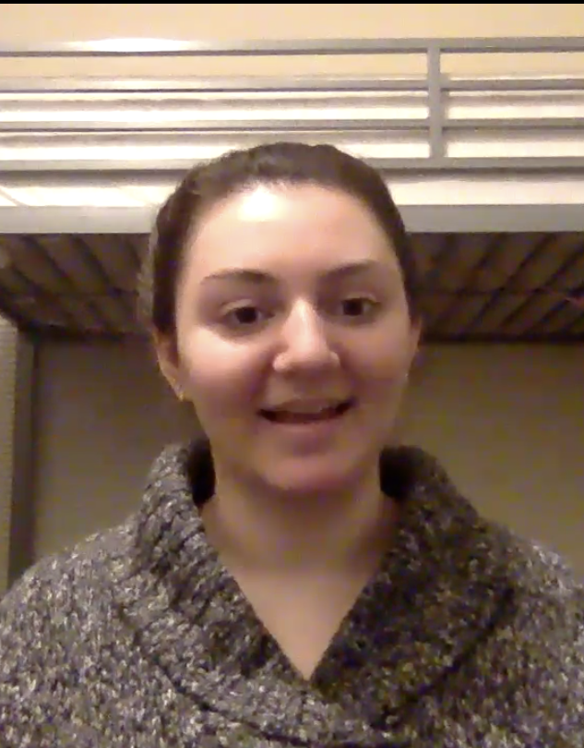
Interview 2
“It’s necessary, I don’t really enjoy it that much but I need to eat, so. It feels more like a task rather than something to do for fun. Like I HAVE to cook in order to eat. Like school work more than a hobby.”
Stephanie
A vegetarian student living with multiple roommates looking to cook when factors at play allow her to
Notes:
Vegetarian so factoring in perspective of user with dietary restrictions
She lives with many roommates so this adds complications when trying to cook
Cooks at night
Doesn’t experiment while cooking, knows basics
Cooks things that keep well considering she can’t go to the grocery store often
Cooked more in highschool, presumably when feeling less busy, and because lived in a small town without much to do
Wont order out individually, but jumps on orders like a social activity
Feels bad when ordering if she could have made it for cheaper
SURPRISE: Change over time in opinion about cooking from highschool to now, she got busier

Slide 9

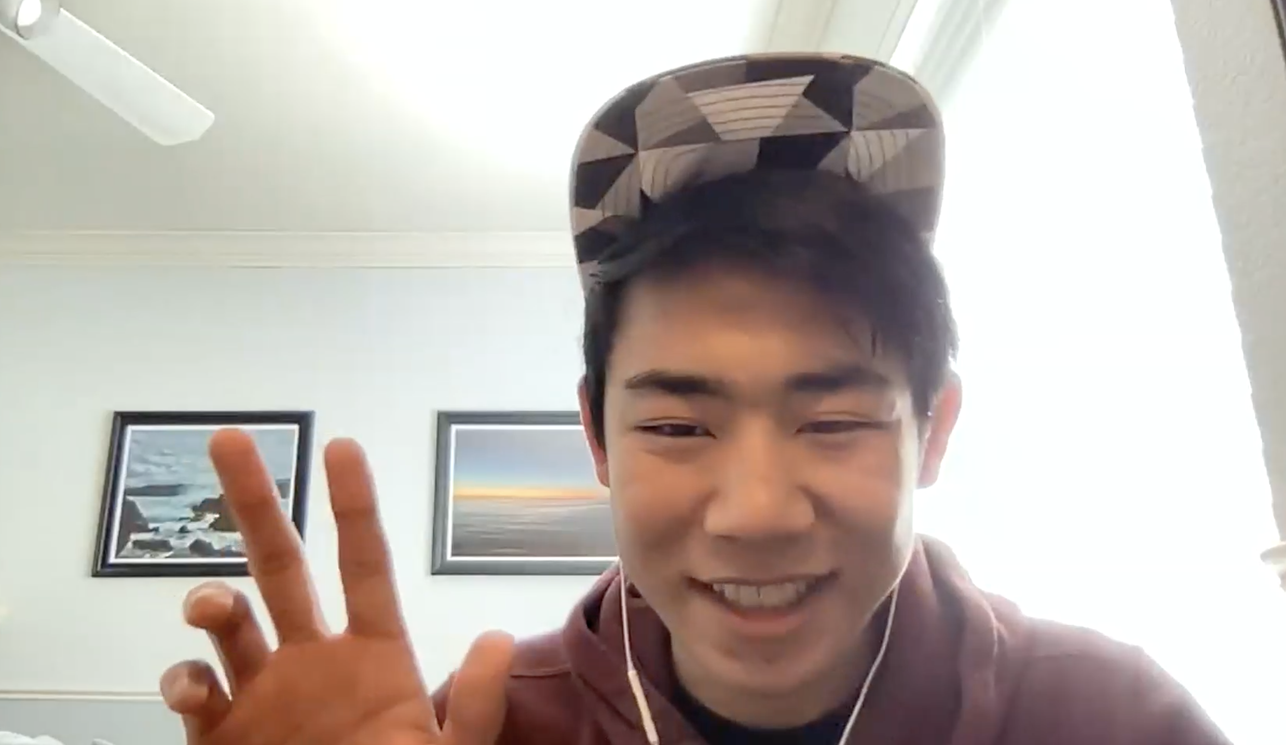
Interview 3
“This like really cool [p]otato thing where they get really crispy if you boil it [in] like baking soda water beforehand. So that was, I was like, really proud of myself for doing that, even though it wasn't that like complex or anything. “
Ethan
A frosh, chemistry major who enjoys experimenting with cooking
Notes:
Young, still new to college and adjusting
Cooks when he needs to eat and enjoys the experimenting aspect
Relatively new to cooking, cooks 3 days of the week
Recipes that look “fun and interesting” - also as appetizing
Always uses a recipe because scared to mess up
Annoyed when things don’t work out
Prefers cooking because its cheaper
SURPRISING: chemistry major influence, experiments with cooking, enjoys that aspect, signifigant for him

Slide 10
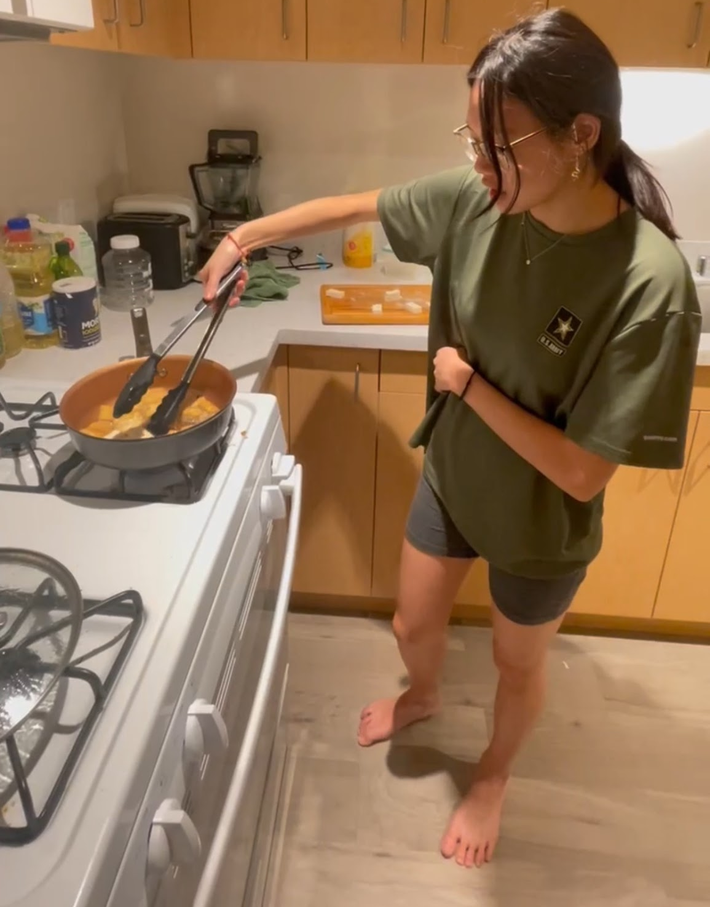
Interview 4
“It’s [cooking] a fun thing to do, except when I’m busy”
Halley
A busy college student in the midst of her junior year who lives with only a roommate and still needs to eat
Notes:
Also a busy person on a pre-med track
Cooks for her and her single roommate
Also orders out a decent amount, living in LA where there is great food all around to buy
She can be making the same thing but depending on the situation around her (time, availability) cooking is seen differently
When she is not as available, cooking is seen as a chore which is interesting considering it involves food which is a necessity for living
Situation dictates how one feels about cooking
SURPRISE: same meal can be annoying or happy depending on her mood, annoying to make or looking forward to it, Chicken dish she makes specifically

Slide 11
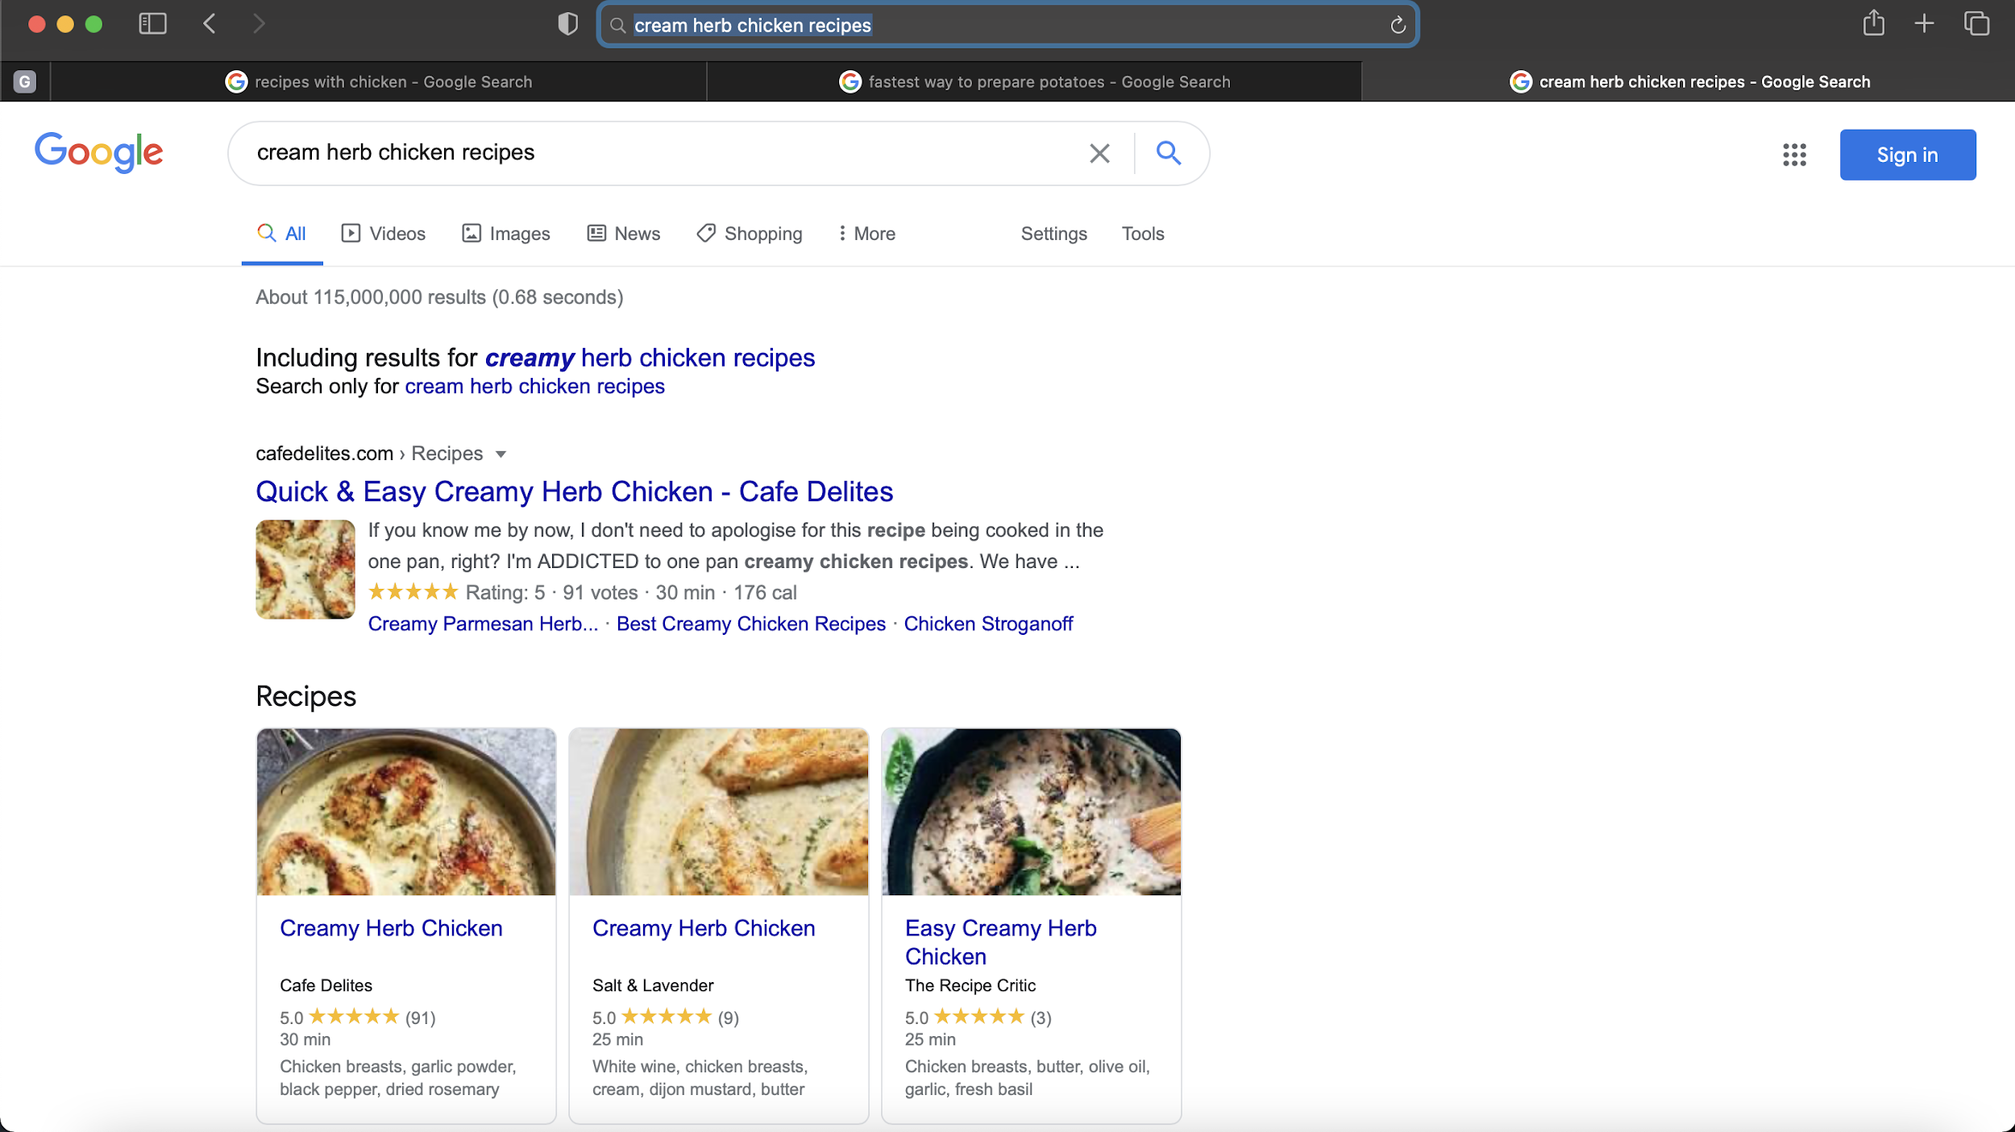
Notes:
Screenshot example of tabs open to explore recipes often done by users
Users not pictures and reviews first

Slide 12
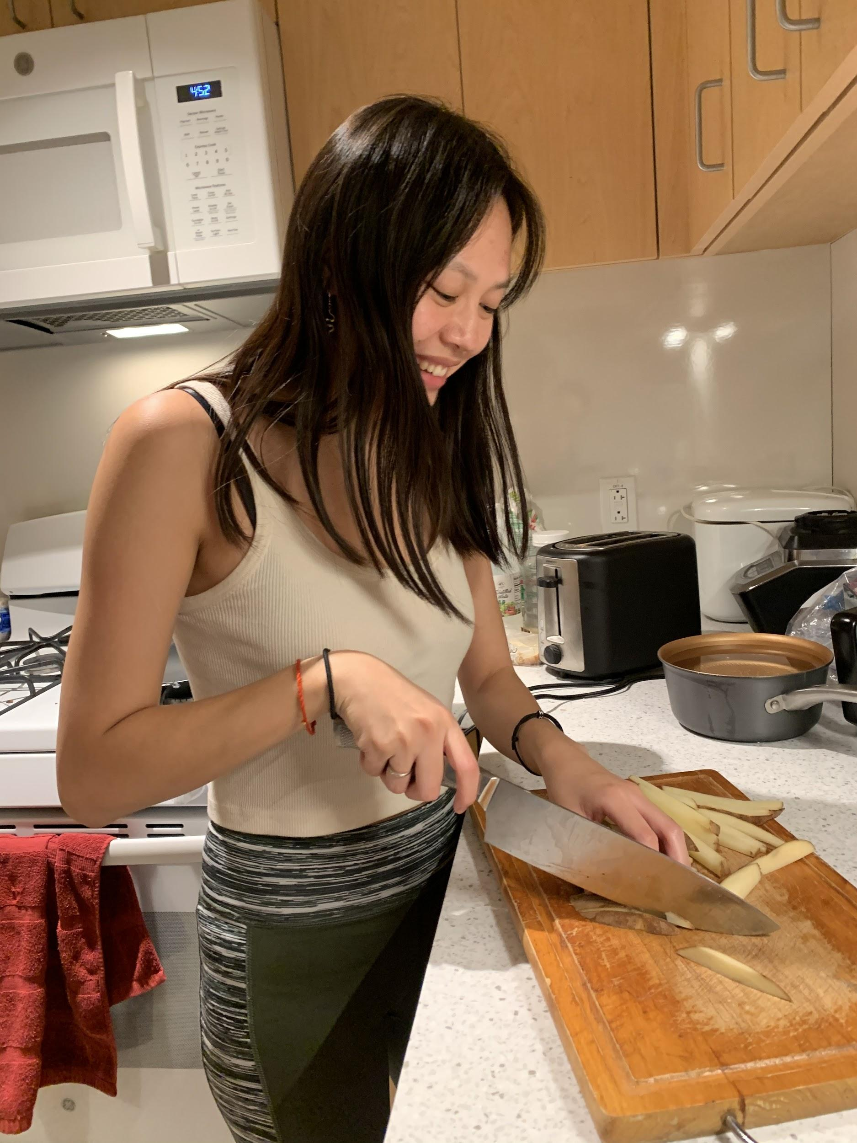

Slide 13
Empathy Map
Notes:
Analysis (3-4 slides)
○ Empathy Map with highlighted components of what you found important/interesting
○ Discuss tensions, contradictions, surprises in the interview
○ Inferences, conclusions, or questions you might have about your results
○ Initial assessment of “needs” and “insights”

Slide 14
SAY
“A fun thing to do except when I’m busy”
“ A lot of times I feel guilty” [about takeout]
I have things [foods] that I rotate through, just things that keep well since I can’t make it to the store often.
“Waste of time during school when I have more important things I should be doing.
“it wasn’t cooking for sustenance it was cooking to enjoy the activity together, so it was kind of a reframing of that.”
“I guess I'm ambivalent... [it] mainly just kind of depends on the situation.
If I'm, if I'm like really looking forward to eating it that I'm like, I'm like, pretty hyped throughout like “yeah that's gonna taste really good.”
“Honestly, I'm a novice I barely know how to cook.”
“Uh, [I started to cook] probably like after coronavirus started.
“I think practice makes perfect. Like, I'm still messing up a lot. So I think hopefully with practice. I'll get better at that.”
“I’m really a control freak when it comes to, like, making sure that I have everything [ingredients].”
“When stuff [the dish] is like just not perfect, just not good. I'm really disappointed in that usually most the time”

Slide 15
DO
Cooks most of her own meals for her and her roomate
Looks in fridge to develop an idea of what to cook
Preps for meal before cooking to have everything ready to go
Gravitates towards simple, mostly prepared or prepackaged meals
Looks up a recipe on Google and checks the pictures and reviews to choose one
Scrolls through instagram looking to replicate recipes she sees and likes
Doesn’t make some meals right away - saves recipe then goes to the store when there is time
Cooks late at night to avoid crowded kitchen
Smiles when talking about cooking with his family
Finds recipes from Google, no specific websites/books
Had to think longer to recall a negative cooking experience
Makes food with intention of having leftovers

Slide 16
THINK
Wishes there was an easier way to clean up after cooking, especially for a large crowd
Most food ordered out is unhealthy
Ordering out is expensive. I can save money by cooking.
I wish places had more vegan/vegetarian options
Google/
Instagram have the widest variety of recipes and are the most engaging
Cooking with others transforms it from a chore to a fun social event
I wish a grocery store was more accessible for ingredients
Baking is more fun than cooking because it is more precise
Cooking is a way to access multiple cuisines in one’s household
Ordering takeout is not as satisfying as eating in a restaurant
I need to research pictures/videos in order to choose what to make
I like to be challenged

Slide 17
FEEL
Joy when cooking with roommate - random, fun conversations while cooking
Feels proud when baking because you can personalize the end product
Stressed when having to cook during busy school schedule
Ambivalent when cooking by herself
Annoyed with cooking that requires a lot of cleaning after or is messy
unadventurous and bound to the recipe
Prouder when taking more responsibility towards final dish
Mediocre feeling when something goes wrong - adapt
Must cook many different types of dishes
Disappointed when the dish doesn’t come out the way the chef wanted to
Stuck when money is a reason that limits the convenience with ordering out
Curious/open-minded when searching for recipes

Slide 18
Insights & Needs
Notes:
Analysis (3-4 slides)
○ Empathy Map with highlighted components of what you found important/interesting
○ Discuss tensions, contradictions, surprises in the interview
○ Inferences, conclusions, or questions you might have about your results
○ Initial assessment of “needs” and “insights”

Slide 19
“There wasn’t a lot to do in our home town, so cooking was something to do to occupy ourselves. it wasn’t cooking for sustenance it was cooking to enjoy the activity together, so it was kind of a reframing of that.”
Insight:
Cooking itself isn’t what people look forward to, it’s the social experience.
Need:
It would be ground-breaking if all cooking experiences were community-oriented / interactive.
Notes:
What prevents cooking from being a social experience now?
Cooking is synonymous with a chore more now
It was a necessity in the midst of busy lives
Surprising to find cooking itself wasn’t intrinsically attractive - it’s things surrounding cooking like conversing with someone in the kitchen
The stories we heard about cooking involved social interaction - the emotionally significant instances were not just about cooking itself

Slide 20
Insight:
Memorable cooking experiences involved challenging or new experiences.
Need:
It would be ground-breaking to give people a sense of exploration while cooking.
“My favorite memory were these crazy, over the top burgers.”
Notes:
This may seem contradictory to the point made just before this but it isn’t
We found that the most memorable stories about cooking involved a challenge or task that was significant in some way
Key word being memorable
A new complicated recipe that turned out well, adapting a recipe with one’s own twist and it tasting good
Essentially, a sense of accomplishment from overcoming something new
Trying something new with low costs, if it didn’t turn out well then it would be okay but if it worked out, it was a significant memory
Cooking is a friendly outlet to try new things which can generally be scary in other activities

Slide 21
Insight:
People pull from a variety of different mediums before cooking (Google, Instagram, YouTube, family recipes).
Need:
It would be ground-breaking to make the process of searching for inspiration more convenient.
“It's like looking at recipes or like seeing, you know, YouTube video [to find] something that I think would be fun.”
Notes:
Surprising: how much time goes into this step before anything is ever made
People lookup recipes from different mediums when they cook something they are unfamiliar with
Thought there would be a more centralized way to explore
What did we expect?:
We expected family recipes and social media as sources to find ideas
How were expectations contradicted?
We were surprised to find that some people don’t cook and their family does instead (if they live with their family)
Cooking cool looking foods or staple meals draw people in
2 sides of a spectrium -> recipes are mainly used for foods people don’t know and not for the staple meals they draw
There was no consolidation between the different resources, all had different information and recipes so time had to be spend filtering through all the different mediums

Slide 22
Insight:
How one feels toward cooking depends greatly on their availability - more so than ingredients or recipe constraints.
Need:
It would be groundbreaking eliminate time constraints while cooking.
“Cooking is a waste of time during school when I have more important things I should be doing.”
Notes:
Initially, we debated the influence of ingredients on users but found it varied a lot
If one really wanted to cook, they’d be willing to get ingredients but if one were not, they would work with what they had willingly
A commonality toward feeling about cooking was time and availability
Found that even those who lived with families and had people cooking for them most days of the week, found it troublesome to have to cook their own meals instead of doing some other activity
Those that had to cook felt a reluctance from time to time when they were busy, but were less bothered when they had the time
Thus, very time/availability influenced
Interesting because cooking = food = necessity for living but is seen as a “chore” or “hastle”
Some people avoid meals all together because of not wanting to cook

Slide 23
Insight:
People are conscious of their wallets when ordering takeout but are less so when grocery shopping
Need:
It would be ground-breaking to contextualize food costs in general.
“When I order out, I feel bad that I could have made it for cheaper.”
Notes:
Users talking about cooking never mentioned price
Users talking about ordering out always mentioned money
Interesting considering cooking and ordering out both use money
Money seemed to have a greater weight and infuence when thinking about takeout but it was almost non existent when thinking about cooking
Contradiction
People do not want to cook because of the time needed to dedicate to it but also don’t want to order out because cooking is thought of to be cheaper
Idea that eating out also is connoted as unhealthy while cooking is not cosidered so
It would be nice to find a way that contexualizes money across food in general

Slide 24
Summary
Socializing is fun and challenges are memorable!
Cooking is all about exploration
Consume lots of media for recipes
Conveniency impacts people’s relationship with cooking
Money, ingredients, and time are some factors with cooking
What’s Next:
Interviewing extreme users
Exploring more in depth about our insights
Notes:
Extreme users
Mother who can be considered an expert
Someone who does not know how to cook at all, burns toast
More general users
Working people to see if adulthood has any variants (access to different income)

Slide 25
Thank you!
Questions?

